Slide 1
Indigenous Ways of Learning, Knowing and Teaching
ETAD 991 University of Saskatchewan November 1st 2017
Caroline, Chris and Tracy

Slide 2
Glossary of Terms
Reserves – mostly now referred to as First nations. Parcels of land set aside and created to control and segregate groups of people. They were designed to ensure prime lands wanted for development by colonizers were available to newcomers. Created and governed by The Indian Act.
Pass System – created 1866 – enforced until 1940’s. First Nations peoples could not leave their reserve unless they had signed authorization by the Indian agent.
Forced Relocation – FNMI populations were all subject to this treatment. The lands that First Nations, Métis and Inuit were forced to move to were located away from bodies of water and traditional harvesting grounds, and were often barren landscapes that were thought to not be rich in natural resources.
Indian Act -Defined who was an Indian; managed Indian lands, resources and moneys; controlled access to intoxicants and promoted “civilization.” • Crown acted as “guardian” until Indigenous peoples were fully integrated into Canadian society.

Slide 3
Cultural Identity Terms
Bill C-31 Indian - A person who gained or regained Indian status because of the Act to Amend the Indian Act, 1985
Ceremonialist - A highly respected member of a First Nation or Métis community.
Elder - Recognized and identified by members of the community as carrying important wisdom, oral traditions and knowledge of their culture.
First Nations - A term used by the Assembly of First Nations (www.afn.ca/en/about-afn/description-of-the-afn)
FNMI - This acronym should not be used to refer to First Nations, Métis and/or Inuit peoples as it is considered offensive by many and often misunderstood.
Indigenous Peoples - Term used globally to refer to the original inhabitants of any region
Knowledge Keeper - Recognized and identified by Elders of the community as being knowledgeable about cultural practices, products or worldviews.

Slide 4
Indigenous Perspectives in Education.
Alberta Education mandates that “In the spirit of reconciliation, the Government of Alberta commits that all Alberta students will learn about the history and legacy of residential schools, along with the history of First Nations, Métis and Inuit peoples of Canada.” 2014
Worldviews and Aboriginal Cultures: Where hearts are rooted
Aboriginal Students: Who are they? How do they learn?
The Classroom: A community of learners
School, Family and Community: Sharing the responsibility
Learning Strategies for Aboriginal Students: Opportunities to make learning meaningful
Assessment: Authentic reflections of important learnings
Teaching Aboriginal Students with Learning Disabilities: Recognizing gifts and strengths
Our Words Our Ways, 2005, Alberta Education.

Slide 5
Implications of the Study for Educators.
Reimagine cultural and pedagogical complexity.
Possible creation of interdisciplinary programs.
Fostering real life experiences in classrooms.
Provide times for reflection and discussion – sometimes of the difficult subjects.
Infusion of multicultural ways of knowing in everyday teaching.

Slide 6
Three Eyed Seeing? Considering Indigenous, Ecological Knowledge in Culturally Complex Pedagogical Settings.
Study was completed by Greg Lowan – Trudeau to explore the complex experiences of newcomers to Canada.
Interviewed Indigenous and non Indigenous Science and environmental educators.
Challenges include the difficulty of reconciling two or more cultural viewpoints.
Purpose was to explore educational experiences of newcomers to Canada with indigenous ecological knowledge.
Three participants – Kathy from England, Sophia from Central Europe and Takwana from Zimbabwe.

Slide 7
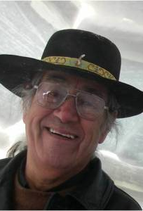

Two Eyed Seeing.
Albert Marshall is an Elder of the Mi’kmaw Nation. Cape Breton University.
Author of the Two Eyed Seeing document.
Inmate of a residential school.
Indigenous ways of knowing with Western ways of knowing.
Why the puzzle piece?
Guiding Prinicple

Slide 8
What is Three Eyed Seeing?
Western Ways of Knowing
Indigenous Perspectives
Other Knowledge Systems

Slide 9
Key Findings of the Study.
Common lack of meaningful exposure to indigenous knowledge.
Importance of critical and experiential approaches.
Potential for reimagining cultural complexity as a strength.

Slide 10
Identity Transformation of participants.
Exposure to indigenous ways of knowing and learning changed the identities of participants.
  Kathy
  relation of perspectives with relatives.
  Sophia
  respect – acceptance – over adoption.
  Takwana
  Aha! moment.

Slide 11
What do you see could be the implications of the implementation of Three Eyed Seeing model in an education Setting?
Why is the preservation of indigenous knowledge necessary? Moving forward how do we achieve a balanced education system that infuses multiple perspectives?

Slide 12
Aboriginal Education and Anti-Racist Education – Solutions – Part 1
Building Alliances across Cultural and Racial Identity – By Verna St. Denis
A look into past-practices of colonization & assimilation, current practices in education and cultural revitalization and the need for anti-racist education.

Slide 13
Introduction
“Identity politics are rooted in our colonial history and Aboriginal students are, in part, living out a long-established, politically charged script of who belongs and what it means to belong to an Aboriginal community”
Verna St. Denis, wanted to address these concerns and “discuss the concepts of identify and identity politics”
Verna St. Denis has struggled with this conflict throughout her life growing up as a child of a “Metis/Cree father who spoke Cree and Mitchif and a Treaty 6, Cree-speaking mother living in a white settler colonial nation”
Notes:
Mitchif- is a language combining French nouns and Cree verbs and spoken by Metis people
The concept of identity politics refers to the processes by which racially marginalized peoples resist colonization and oppression

Slide 14
Race, Racialization and Identity Politics
“Rather than thinking about identity as innate and individually determined, it is much more helpful to understand one’s identity as a construction, a product, and an effect of social and historical relations” (It is complicated)
A cultural identify comes from history – Hall’s Definition ‘stresses the importance of history and social relations in the production of identities, and it is this notion of identity that is helpful for analyzing the effects of colonization and racism on Aboriginal people”
Racial identity struggles are not unique to Aboriginal people, but are widespread and exist in social, educational, political and economic institutions
“Race matters because members of society have internalized racist ideas about what skin colour tells about the value and worth of a person

Slide 15
Historical Practices of Racializing Aboriginal People
In the beginning of colonization during the fur trade racializing began, it continued with the Indian Act and started to shape how Aboriginal People were viewed in our culture
Then residential school education was put into place, which continued to shape the divide
The White Paper “became the single most powerful catalyst of the Indian nationalist movement, launching it into a determined force for a nativism – a reaffirmation of a unique cultural heritage and identity”
Aboriginal people began resisting and starting gathering to affirm Indigenous cultural traditions and values, this gathering turned into the Indian Ecumenical Movement
The revitalizing process had begun and it was a healing process for many Aboriginal people
Notes:
White skin started to matter and this set in motion who belongs and who was ignored or excluded
During the Indian Act – Indian Women lost their rights to Indian Status and the right to live on reserve, for example
Residential Schools – Aborignal people lost their language (it was beaten, shamed and tortured out of them)

Slide 16
Cultural Revitalization and Fundamentalism
Despite Cultural Revitalization attempts, there have not been always liberating and healing towards Aboriginal People as they were intended
“When Aboriginal teacher education programs were established across Canada, their mission included producing Aboriginal teachers who would play a central role in language and cultural revitalization”
“The ability to speak one’s language has become and important sign of one’s cultural authenticity,” but when that language has been lost for years and classes teaching that language are not readily available then there are still challenges
Many aboriginal grandparents and parents are now being told they made the wrong decision by encouraging their children to become fluent in English over their own cultural languages so they would have a better chance at fitting in
“The tension is poignantly evident in the example of Aboriginal teachers, some of whom are very knowledgeable of their cultural traditions and languages and many others who are not – and most often, not by their own choice”

Slide 17
Aboriginal Education and Anti-Racist Education – Solutions – Part 2
Building Alliances across Cultural and Racial Identity – By Verna St. Denis
A look into past-practices of colonization & assimilation, current practices in education and cultural revitalization and the need for anti-racist education.

Slide 18
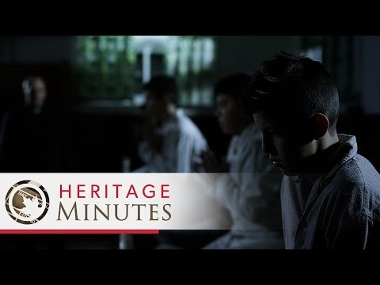
The impact of Residential Schools
https://www.youtube.com/watch?v=v_tcCpKtoU0

Slide 19
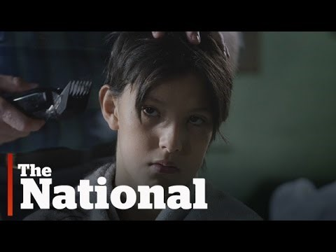
Highlighting residential school’s impact.
https://www.youtube.com/watch?v=TK483UHGd7k

Slide 20
What is racialization?
According to Wikipedia:
In sociology, racialization or ethnicization is the process of ascribing ethnic or racial identities to a relationship, social practice, or group that did not identify itself as such.^{[1]}
Racialization or ethnicization is often borne out of the interaction of a group with a group that it dominates and ascribes identity for the purpose of continued domination.
While it is often borne out of domination, the racialized and ethnicized group often gradually identifies with and even embraces the ascribed identity and thus becomes a self-ascribed race or ethnicity.
These processes have been common across the history of imperialism, nationalism, and racial and ethnic hierarchies.
Anti – Racist education explores the practices, processes, and ideologies of racialization, which includes not only how racism disadvantages some, but how racism advantages others, and how whiteness gets produced and constructed as superior (Macintosh, 1998).

Slide 21
Racism is systemic, based on past colonial practices considered traditions and deeply rooted.
Aboriginal teachers’ lives are a testament to the ongoing legacy of racialization in Canada.
Aboriginal teachers, both Metis and First Nations, repeatedly spoke to the reality that skin colour does matter in terms of how they were received. (St. Denis pg. 1081)
Aboriginal teachers are well aware that “the more visibly Aboriginal you are the more you are bound to experience racism” (St. Denis et al., 1998, p 40).
In Saskatchewan there is nothing lower than being Indian” (St. Denis et al., 1998, p. 39)

Slide 22
Questions
Please pick one of the following:
Have you ever experienced (first hand or witnessed) racism towards First Nations / Metis people? How did you react? What would you have done differently?
As an educator, how have you integrated First Nations ways of knowing into your classroom.
As an educator, have you ever taught a lesson on, or spoken to your students about residential schools? Describe this experience.

Slide 23
Is Cultural Revitalization the full solution to racial issues?
Cultural Revitalization is the act of celebrating and taking part in your cultures way and practices as a way of reconnecting with it.
Cultural Revitalization is only part of the solution and ironically, as a solution, it also contributes to other problems for some Aboriginal people. As a solution, cultural revitalization places the burden of change on Aboriginal peoples, yet again. (Chief John Snow, 1977)
Although cultural revitalization is liberating for many, it can also function to blame the victim, suggesting that social problems faced by Aboriginal people occur because Aboriginal people have lost their culture, they failed to get it back, and/or they are not doing their culture properly.
We, First Nations people, must broaden our solutions to inequality (Verna St. Denis)

Slide 24
How do we approach the solution?
Much effort has gone into developing and advocating culturally relevant education, including incorporating cultural traditions and practices into schools as well as developing culturally relevant curriculum content in for all subject areas. (p. 1083)
But what these interventions do not address is the racism that youth face on a daily basis.
There is a need for a national anti-racist educational initiative, because it is clearly not possible to challenge people’s deeply entrenched negative views of Aboriginal people in brief encounters and piecemeal, one time units/lessons (St Denis with additions)
Perhaps educators need to call for the widespread offering of a critical anti-racist education as a requirement at all universities across Canada. (St. Denis)

Slide 25
What can we do as educators
We need to offer both non-Aboriginal and Aboriginal teachers and administers opportunities to learn more about racism and how its effects, especially the ideology of and belief in the superiority of whiteness, shapes both Aboriginal and non-Aboriginal members of society. (St. Denis, p. 1083)
By acknowledging a common experience of colonization and racism, educators can enact solidarity and join together to challenge racism and racialization.
Educators must be examples of collaboration and cooperation, across our diversity, in spite of the many challenges we face. (St. Denis p 1087)

Slide 26
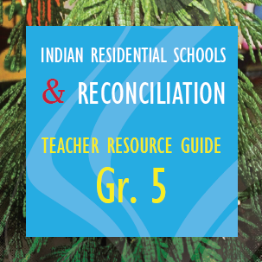
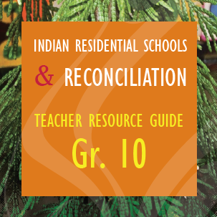
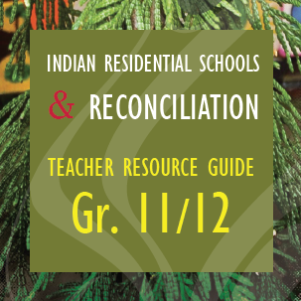
How do we move forward and work to teach anti-racist education and true multi-culturalism in schools
The Indian Residential Schools and Reconciliation Teacher Resource Guides for grades 5, 10 and 11/12 were developed by the First Nations Education Steering Committee and the First Nations Schools Association.
https://vimeo.com/136350623

Slide 27
Resources to help teach about residential schools and anti – racism education:
Gord Downie’s – The Secret Past: https://www.youtube.com/watch?v=yGd764YU9yc
The Secret Path in the Classroom: https://www.youtube.com/watch?v=Hz5J0uy9YVE
Truth and Reconciliation Commission of Canada: Calls to Action
http://www.trc.ca/websites/trcinstitution/File/2015/Findings/Calls_to_Action_English2.pdf
Residential schools and reconciliation
http://www.fnesc.ca/irsr/

Slide 28
Final Thoughts
“We are at the start of something… that could be big” – Starleigh Grass, Ted Talk
“It has taken 150 years to get into this mess… and it will take 150 to get out” – Chief Justice Sinclair.

