Slide 1
How to Graph an Expression
Chris Bennington
ETAD 803
Multimedia Design for Learning
June 27, 2016.

Slide 2
The Steps to Graph an Expression.
  Gather your Supplies
  Build a table of values
  Calculate the output
  Draw the axis
  Plot the data points
  Connect your data points
Notes:
In order to graph the equation you need to follow the following steps:
Preparing to solve the equation 2x+3
Designing a table of values
Graphing the expression

Slide 3
Step 1:
Gather the Required Supplies
  HB pencil
  One sheet of loose-leaf paper
  One sheet of graph paper.
  Ruler
  Calculator (optional)
Notes:
Before you can begin to solve this math problem you need the right supplies.
Gather the above supplies. Place items on table. Have pencil and paper in front of you.
You may put the graphing paper to the side you will need them later after you make your graph. You are now ready to start.

Slide 4

Step2:
Build a Table of Values
  Grab your loose leaf paper
  Design a two column table that goes ¼ of the way across the page and 6 lines down.
  Write the expression 2$x$+3 above your table.
Notes:
Designing a table of values allows you to be able to design the graph.
You will need to complete the table correctly in order to know where to put the data points on the graph later.
This table of values is known as the Input/Output table.

Slide 5
Step2:
Build a Table of Values
Write the word “Input” into the first column and first line of the table.
Write the word “Output” into the second column and first line of the table.
Below the word “Input” label each line down with the numbers 1 - 5.

Slide 6
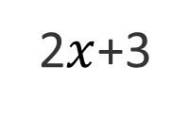
Table of Values
2$x$+3
Input | Output
1
2
3
4
5
Notes:
If you followed the directions closely your table of values should look similar to this one. Its now time to calculate the “Output” for the table.

Slide 7
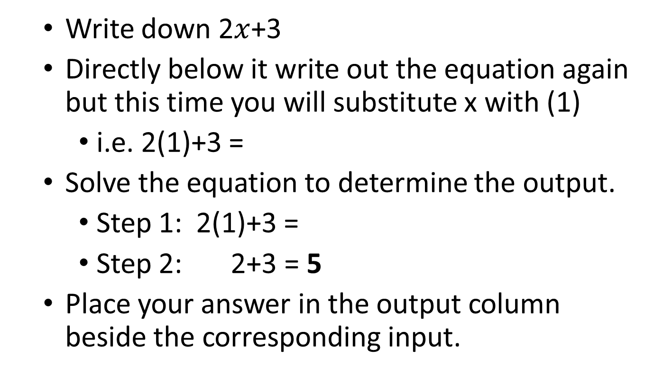
Step 3:
Calculating the Output
  Write down 2$x$+3
  Directly below it write out the equation again but this time you will substitute x with (1)
    i.e. 2(1)+3 =
  Solve the equation to determine the output.
    Step 1: 2(1)+3 =
    Step 2: 2+3 = 5
  Place your answer in the output column beside the corresponding input.
Notes:
You are now ready to fill in the output portion of your table. Beside or below the table of values you will do your work to determine the output for the expression: 2$x$+3.
The $x$ in the expression in known as the variable. Meaning it can change. You will be substituting in your input values for $x$.
Remember to follow the order of operations when calculating the output.
2$x$ means 2 times a number. In the first case that number will be 1 so it is 2 times 1 then add 3. Here you can see how we can solve to find the output step by step.

Slide 8
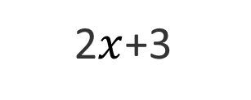
Updated Table of Values
2$x$+3
Input | Output
1 | 5
2
3
Notes:
Place the answer “5” beside the input 1 in the output column.
Lets calculate one more output together to ensure we are doing this correctly.

Slide 9
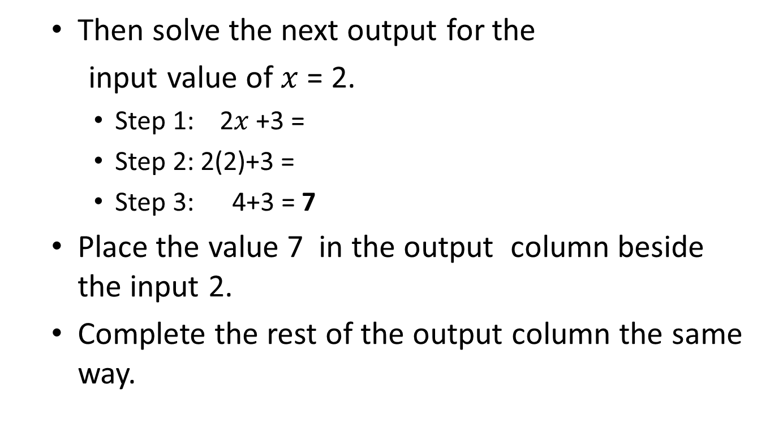
Step 3:
Calculating the Output
  Then solve the next output for the
  input value of $x$ = 2.
    Step 1: 2$x$+3 =
    Step 2: 2(2)+3 =
    Step 3: 4+3 = 7
  Place the value 7 in the output column beside the input 2.
  Complete the rest of the output column the same way.
Notes:
Lets work through the steps to solve the expression 2$x$+3 where $x$ now equals 2.
Remember that 2$x$ means 2 times a number. In this case it will be 2 times 2 then we add 3 to the product.
You end up with the output value of 7.
Now that we have done 2 together, see if you can fill in the rest of the table on your own.

Slide 10
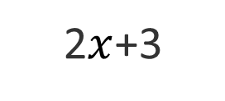
Finished Table of Values
2$x$+3
Input | Output
1 | 5
2 | 7
3 | 9
4 | 11
5 | 13
Notes:
Once you have calculated your table of values you should end up with these results.
You are now ready to graph your data! Grab your graph paper for the next step.

Slide 11
Step 4:
Draw the Axis
  Finding the Origin
    Mark a point 17 lines down from the top and 6 lines to the right of the left edge of your page.
    Label this point 0 – this is your origin point.
Notes:
When drawing a graph you need to ensure that they are neat.
The important point here is the origin point. It is the place where the vertical line of your graph and the horizontal line meet. This point is always marked with a 0.

Slide 12
Step 4:
Draw the Axis
  Draw the vertical axis of your graph.
    Draw a line from the origin straight up.
    Use a ruler to keep it neat
    Leave 3 lines from the top not marked.
Notes:
When drawing your axis on your grid paper use your ruler to make straight lines and use the grid lines to guide the edges of your graph.
We then draw lines out from the origin to cover the distance that the data tells us in our table of values. This line is known as the y-axis.

Slide 13
Step 4:
Draw the Axis
Draw the horizontal axis of your graph.
  Draw a horizontal line 12 grid lines to the right from the origin.
  Use a ruler to keep it neat.

Slide 14
Step 4:
Draw the Axis
Numbering your horizontal and vertical axis.
  Number each grid line going up from the origin from 1 to 13.
  Number each grid line to the right of the origin 1 to 5.
Notes:
We will now number the axis’ so that we cover the range of out data. You will notice that our output has numbers from 5 to 13. We want to ensure that we can graph all the points on our graph so we plot numbers 1 through to 13 up the vertical side of the graph. The vertical side is known as the output.
We then label the horizontal side of the graph 1 to 5 for the input. As you probably guessed the horizontal side of the graph is known as the Input. Now that our graph is ready we are now ready to plot our data points for the expression 2x+3.

Slide 15
Step 4:
Draw the Axis
Label your vertical and horizontal axis.
    Label the vertical axis the Output and the horizontal axis the Input.
Notes:
Labeling the Axis allows the person looking at your graph to know what it is your showing.
Later, when we start to solve word problems, we will replace the Labels “Input” and “Output” with words that describe what the graph is calculating.

Slide 16
Step 5:
Plot the Data Points
Plot the first data point
  You will plot the first data point (1,5) from the table.
  Starting at the origin go one line to the right then 5 lines up on your graph.
  Place a small dot there with your HB pencil.
Notes:
Using your table of values on your loose leaf paper you will now plot your data on the graph paper. Start with the input value 1 and lets follow the steps on the slide.
The dot should line up with the line you marked 1 on the horizontal axis and the line you marked 5 on the vertical axis.

Slide 17
Step 5:
Plot the Data Points
Plot the second data points from your table.
  You will not plot the second data point (2,7) from your table.
  Go over 2 lines to the right then 7 up from the origin.
  Place a small dot here with your pencil.
Notes:
Once you have the first point plotted correctly go to the second input value.
You notice that the second input has an output of 7. So go across the horizontal axis to 2, then up the vertical graph line till you reach the 7. Mark a dot with your pencil.
Remember to check to make sure that your dot matches up with the 2 line you labeled on the horizontal axis and the 7 line on your on your vertical axis.

Slide 18
Step 5:
Plot the Data Points
  Plot the remaining data points from your table.
    Plot point 3 to 5 off your table of values.
Notes:
Now you know how to plot points on a graph!
On your own plot the remaining data points onto your graph.

Slide 19
Step 6:
Connect you Data Points
  Take your ruler
  Lay the ruler along the data points.
  Use your ruler to draw a line connecting the data points.
Notes:
The easiest way to ensure that the graph you plot is correct is that all your data points line up in a straight line.
The line may extend past your data points in both directions.
If the point do not make a straight line then you have made a mistake somewhere. Look at which point is off and go back and try to determine if the mistake was made in calculating the table of values or if it is was in plotting your data points.

Slide 20
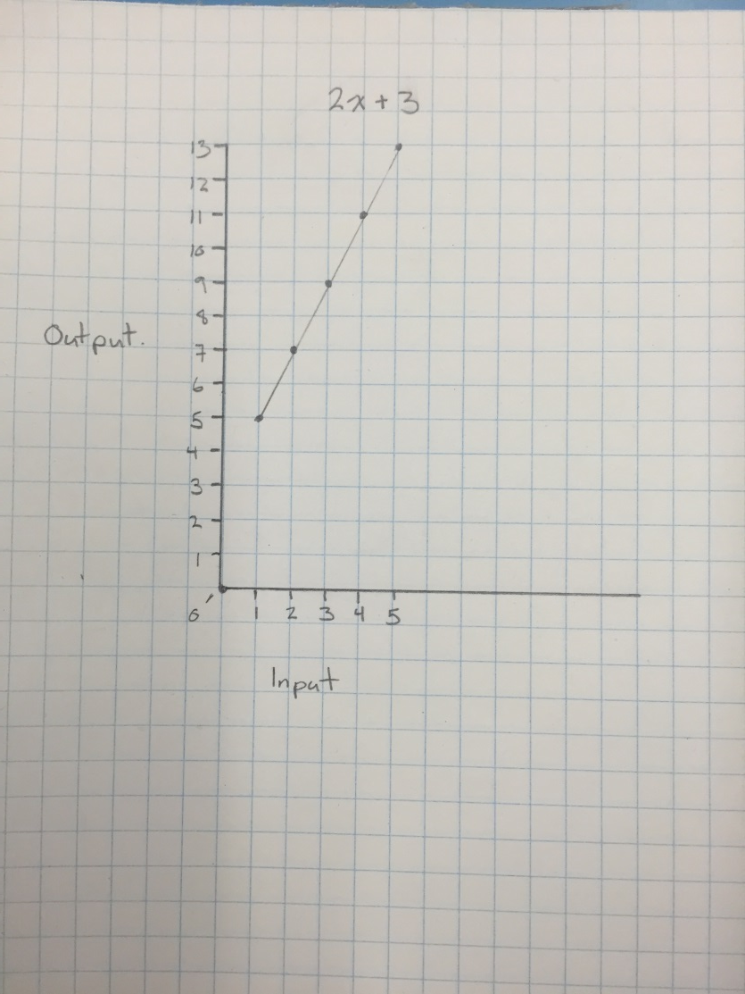
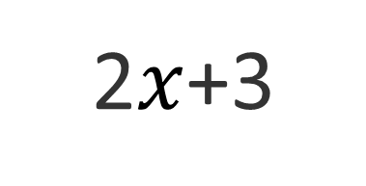
Final Graph of Expression
2$x$+3
Notes:
Your graph should look like this.
If it did great job!
If not, don’t worry, lets try to determine where the mistake was made. With practice you will get better at this.

