Slide 1
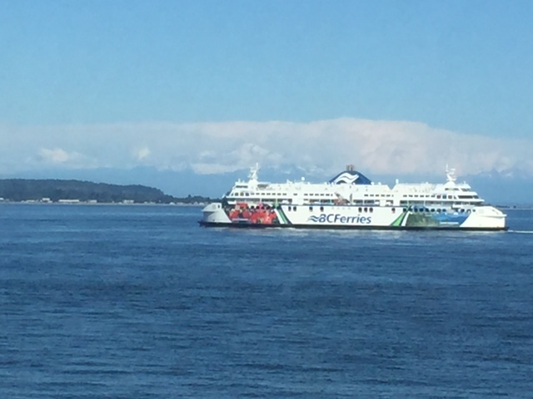
BC Ferries Virtual Tour
By: Chris Bennington
For ETAD 803
Notes:
BC Ferries is one of the ways to travel when visiting Vancouver Island. This virtual tour gives you a chance to see what it is like to travel on BC Ferries and the sites and services provided.

Slide 2

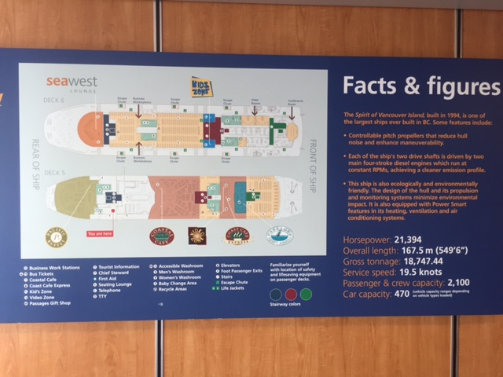

Facts and Figures about the Ferry
Notes:
BC Ferries first started back in the 1960s with two small ferries and two terminals. According to the BC Ferries website (www.bcferries.com/about) the BC Ferries company has grown into one of the largest and most complex ferry companies in the world. BC Ferries has 35 unique ships that service 47 different ports throughout the BC Pacific coast.
For today’s tour we are riding on the Spirit of Vancouver Island. Built in 1994, it is one of the largest ships to ever be built in British Columbia. The ship also happens to be one of the most environmentally friendly and comfortable ships to travel on. Lets take a look at some of the services and sections on this ship.

Slide 3
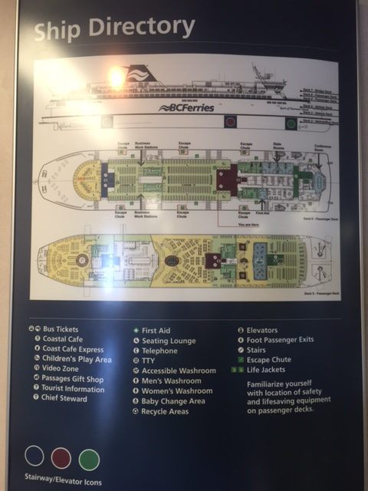
Pick your tour
Using the ships directory choose where you would like to go on the ship. You may click on areas of the map or the legends first column below.
You may also wish to just follow the prescribed tour. If so just hit the next slide button.
To return to this directory simply click the following button at the bottom of the slides.
Notes:
This is one of the many ship directories located throughout the ship. This directory has been adjusted so that you can take a virtual tour of any section of the ship by simply moving your cursor over the area and clicking. Feel free to use this directory to get more information about certain services provided, or feel free to follow this tour by simply clicking the next slide button or anywhere off the ship directory picture.

Slide 4
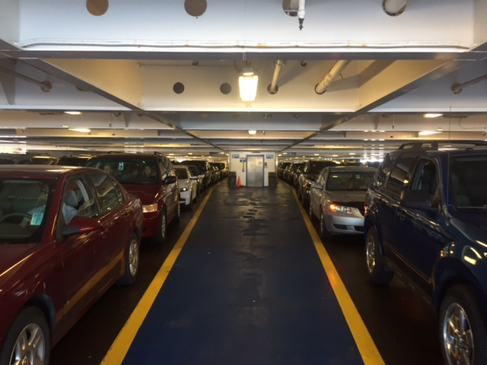
Vehicle Decks
Notes:
After you board the ferry in your vehicle you will be parked on the 2 vehicle parking decks. The upper deck, pictured here is for cars, vans and small trucks. The lower deck has a higher roof and can support semi trucks, campers, trailers and larger vehicles. The Spirit of Vancouver has the capacity to hold 470 cars and over 2000 people!
Residents of the island who travel frequently, or very tired drivers sometimes just crack a window and stay in their vehicles for the trip, which takes around 1 ½ hours from Tsawassen Terminal on the mainland to Swartz Bay on Vancouver Island. But this is boring! There is so much to see and do on the ferry. In order to get to the uppoer decks head for the elevator, pictured here in the middle of the picture or one of the many stairwells located behind a sliding door along the centre column of the ship.

Slide 5
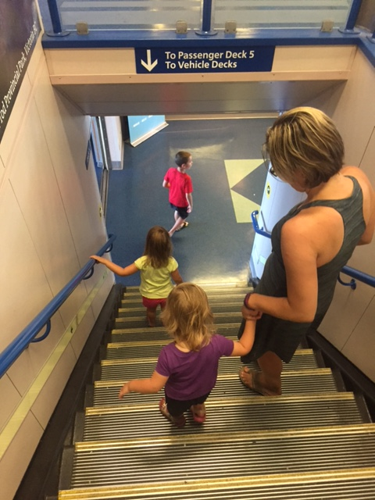
Stairways to the upper decks.
Notes:
There are 5 decks that passengers can roam on when on this ferry. The lower two are the vehicle decks while the upper three are a combination of viewing areas, restaurants, gift shops and a variety of other services. Stairwells like the one in the picture connect all the decks. The stairwells can be quite steep so be careful when using these with small children.

Slide 6
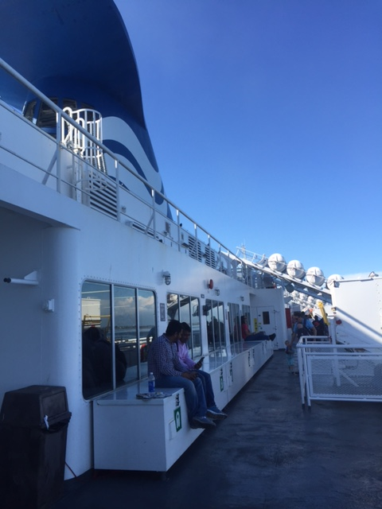
Outside Decks
Notes:
One of the first places to go check out on the ferry is the outside observation decks. Located all over the ferry on all three levels, these decks provide a refreshing breeze and great views of the ocean passageways and islands on your travels. The picture above shows the layout of the deck on the either side of the ship.

Slide 7
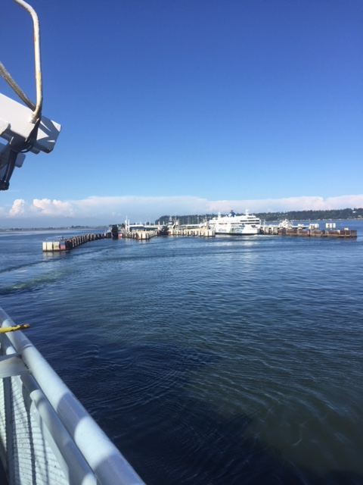
Notes:
One of the favorite past times is to watch the ship leave the port. It is possible to spot many sea birds, seals, and other creatures in the waters around the port.

Slide 8
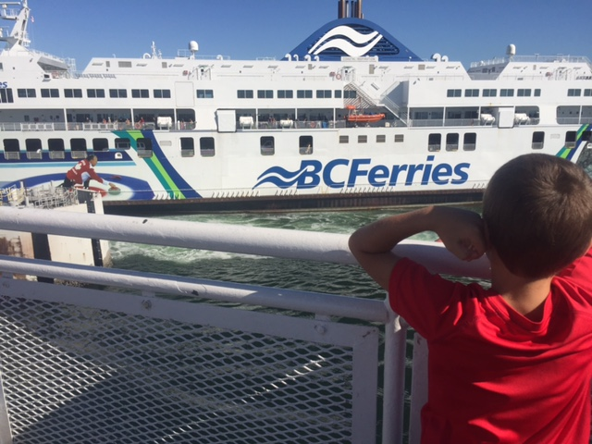
Notes:
In some cases you also get a chance to see another ferries come by as you get started on your journey. Here we saw a Ferry coming into dock from Nanaimo just as we were getting underway.

Slide 9
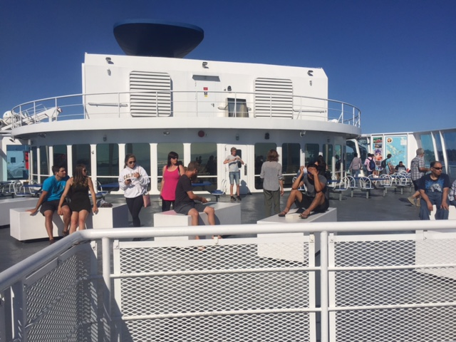
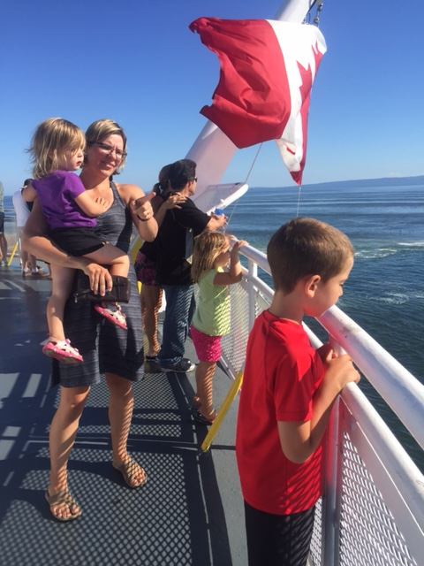
Rear Observation Deck
Notes:
At the rear of the ship in a large observation area that is protected from the wind. Passengers love to sit here on the benches and chairs during their trip. They can sun tan, read and watch the other boats go by from this great open area.

Slide 10
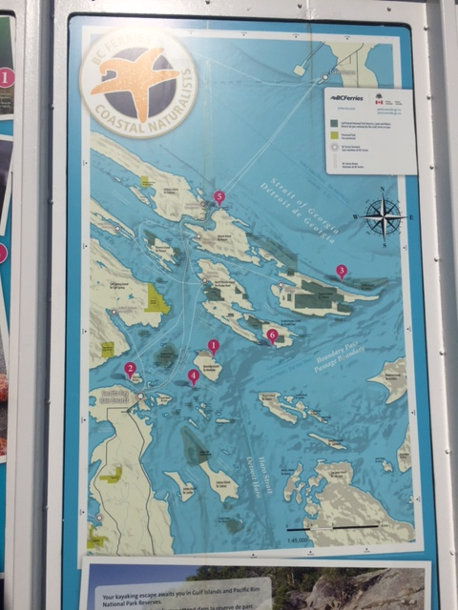
Map of our Route
Notes:
Spread throughout the ship are maps showing the variety of ferry routes in the area. The route we are taking is highlighted in blue.

Slide 11
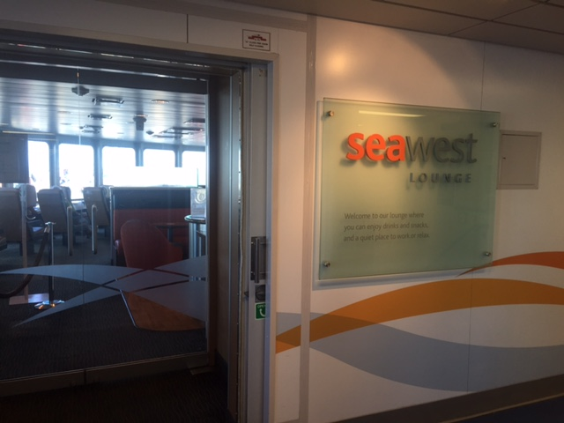
Seawest Lounge
Notes:
Located on deck 6 and popular with business travelers and adults the Seawest Lounge is a great are to sit and relax, completely private passangers can get a coffee, alcoholic drinks, read a magazine or a newspaper or grab a small bite in peace and quiet (think no kids!). Passengers also have a great view out the front of the ferry as it travels. Cost is $12.00.

Slide 12
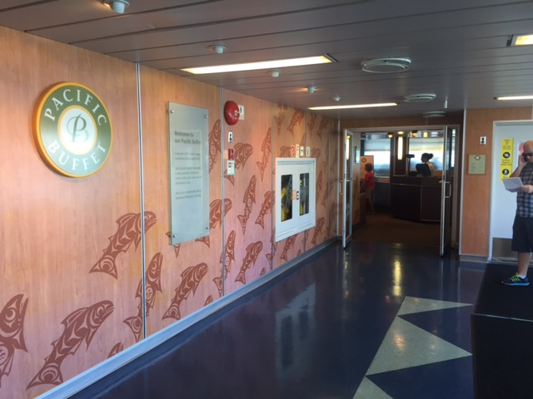
Pacific Buffet
Notes:
If you happen to be really Hungry the Pacific Buffet is a great place to refuel. Many travelers head straight here once they board the ferry in order to grab a meal after a long drive, especially if you came from Saskatchewan! The buffet includes hot and cold items along with a great dessert bar and best of all, you can go back for more! Cost is 18.50 for adults and $10 for children 5 to 11.

Slide 13
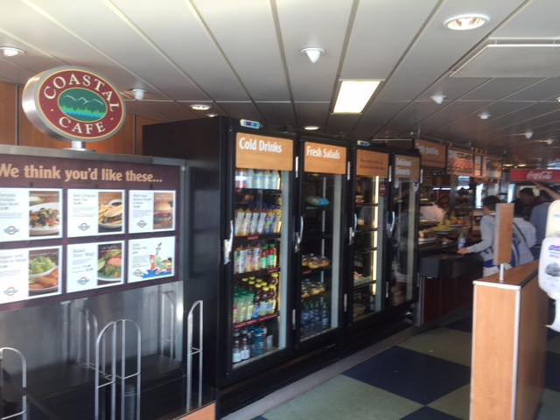
Costal Cafe
Notes:
One of the largest eating areas on the ship, the Costal Café offers a wide variety of food from hot appetizers like burgers, chicken fingers and fries to more local fare such as Pacific Salmon salads. Best thing about this option is you can pick how much or little you want to eat for reasonable prices.

Slide 14
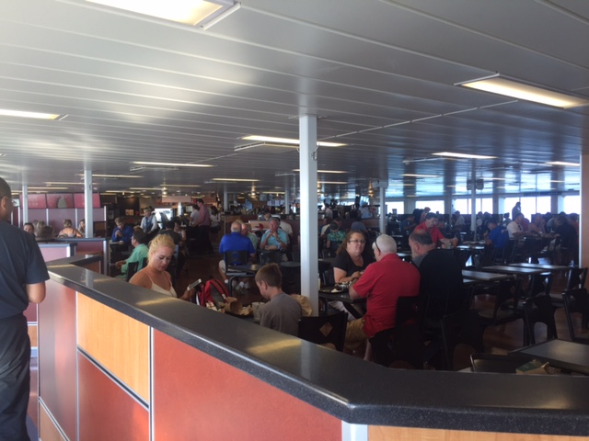
Notes:
The Costal Café is located in the centre of the ship and yet still has great views out the windows of the surrounding ocean and islands. As you can see it is very popular and on packed ferries you can expect lineups to get your food. In spite of the large crowds the service is excellent and all patrons get their food quickly and tables are cleared promptly once passengers are done.

Slide 15
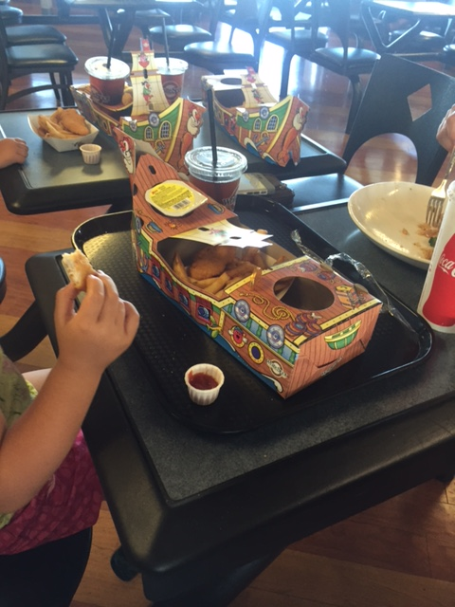
The Pirate Ship Meal.
A hit with the kids!
Notes:
Got Kids? Then a great option for them is the pirate ship meal which comes with a variety of hot entries from burgers to chicken fingers, a cold fountain fresh drink, pudding and even a gold (chocolate) coin.

Slide 16
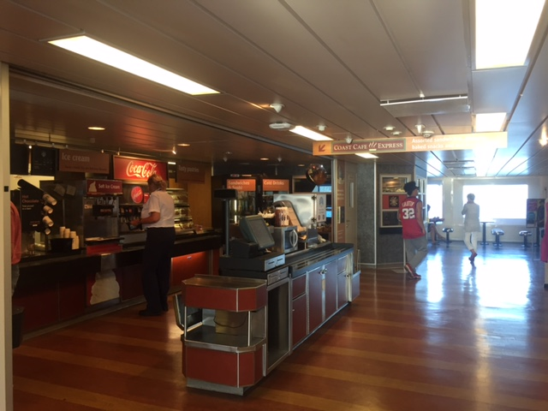
Coastal Café Express
Notes:
If your not in for a meal but need to pick up a coffee and a small bite then try out the Coastal Café, located near the Passages gift shop for a quick bite.

Slide 17
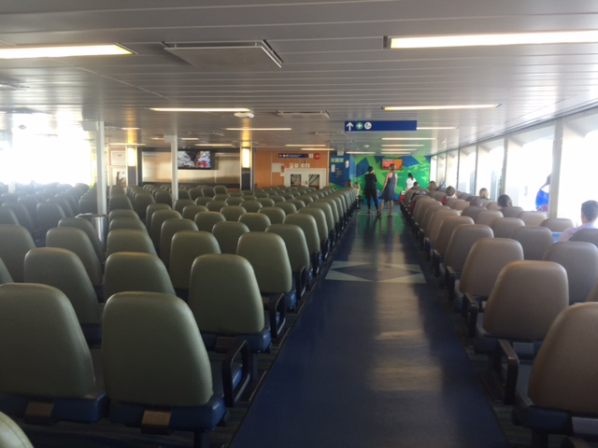
The Viewing Areas
Notes:
There are a number of very comfortable viewing areas throughout the ship. They provide places for you to look out the windows or watch local news, sports and weather on the flat screen TV’s.

Slide 18
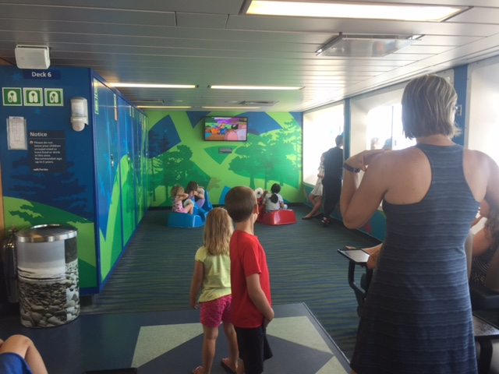
Infant Play Area
Notes:
At the front of one of the larger viewing areas is a Infant play area with toddler toys and a TV screen playing Treehouse TV for the kids. Tired parents especially enjoy this area as they can watch their kids and still be able to watch adult TV or look out the windows. If your kids are 5 or older you will need to look for the kids arcade area for them.

Slide 19
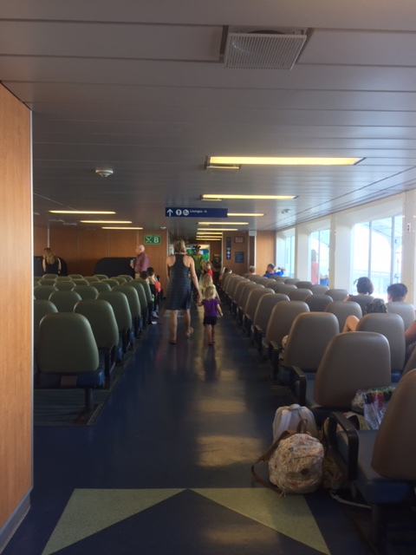
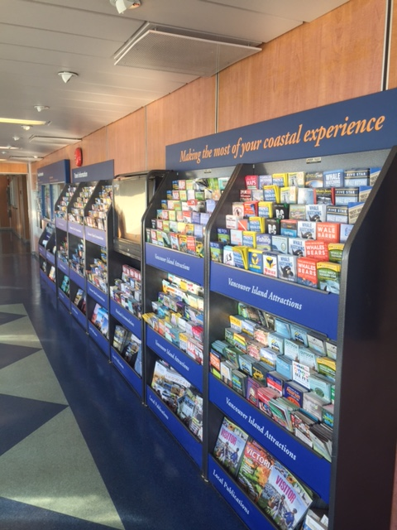
Tourism Information
Notes:
On both sides of the ship along the corridoors you will find a wealth of tourist information brochures. If this is your first time on the ferry check out the great information about services and tourist sites on the island. You can also ask the staff for recommendations too.

Slide 20
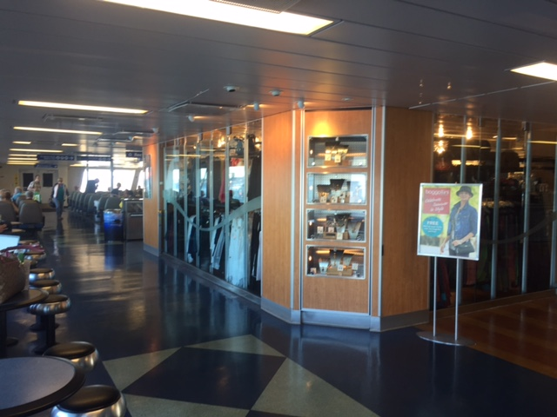
Passages Gift Shop
Notes:
Forgot something? Need a gift or souvenir? Need some reading material? Check out the Passages gift shop for all your needs.

Slide 21
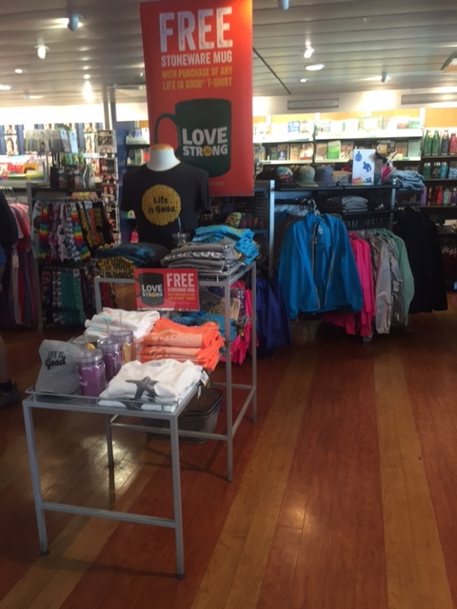
Lots of great gift ideas and souvenirs!
Notes:
The shop also tends to have a variety of sales going on for the bargain shopper.

Slide 22
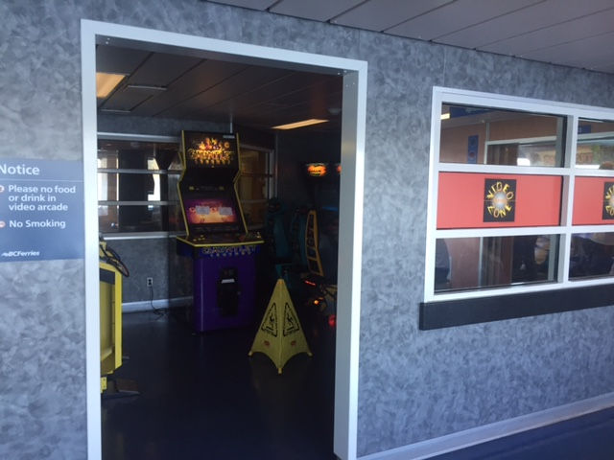
Kids Zone - Arcade
Notes:
A favorite with the kids and the kids-at-heart. The Kids Zone arcade provides a vintage gamers experience. Don’t forget to pack your quarters.

Slide 23
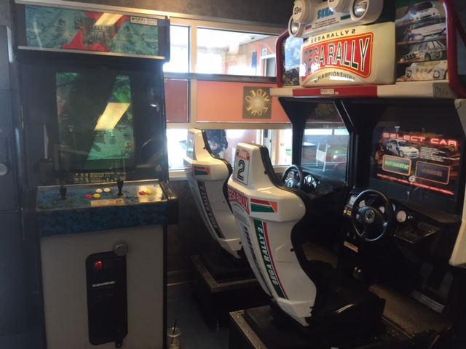
Notes:
You will find a wide variety of arcade games from Rally car to Pac Man and many different titles in between.

Slide 24
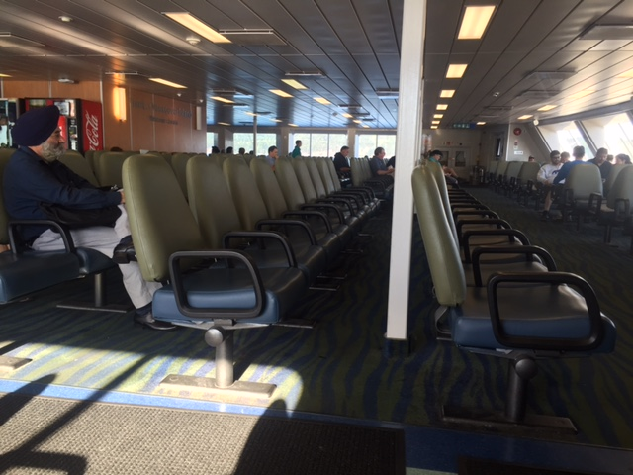
Front Observation Lounge
Notes:
The forward observation lounge allows you to sit back and enjoy the trip in internal comfort. A great area to be if your not up for fresh air, there is bad weather and you still want to enjoy the view. Best of all it’s free.

Slide 25
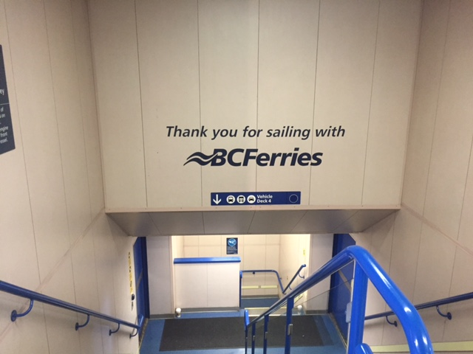
Notes:
At the end of your trip its time to head back down to you vehicle. This sign will great you as you get ready to depart.

Slide 26
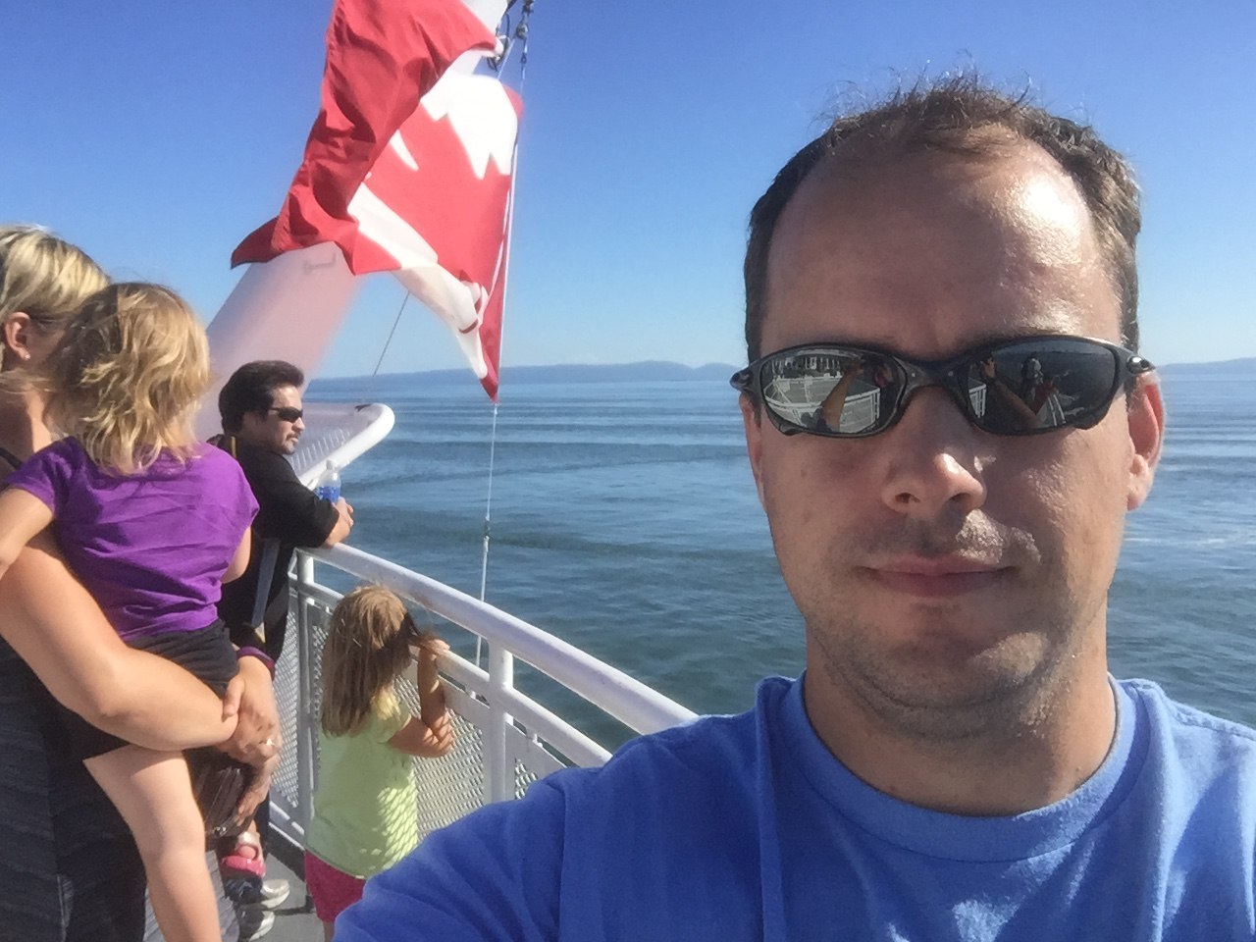
The End of the Tour
That concludes our BC Ferries Tour!
If you wish to view it again press the BC Ferries icon.
Notes:
That concludes the tour of the Spirit of Vancouver Island BC ferry! I hope you have enjoyed the trip and hopefully plan to try it in real life in the future.
Thanks for watching.
Sincerely,
Chris Bennington.

Slide 27
Sorry.
This area is off limits for ferry passengers.
Notes:
Oops! You clicked on an area you are not allowed to go into. Good thing your not sneaking around on the real trip. That would land you in trouble. To get back to the directory simply click on the BC Ferries icon.

